Slide 1
SUPPORTING THE Progress Report in MATH

Slide 2
Domain will only show on the appropriate grade-level report
Mathematical Topics by Domains
Sub-scores
MP 1 MP 6
MP 2 MP 3
MP 4 MP 5
MP 7 MP 8
Mathematical Practices are thinking skills that children use to apply their knowledge of mathematical content
Overall score
Notes:
This is the layout of the new elementary progress report for math. The Standards for Mathematical Content are listed by Domains for each grade level. The Standards for Mathematical Practices are grouped according to the work of Dr. William McCallum of the University of Arizona, one of the main authors of Common Core Math. Problem Solving and Precision is Math Practices 1 & 6. Reasoning and Explaining is Math Practices 2 & 3. Modeling and Using Tools is Math Practices 4 and 5. Seeing Structure and Generalizing is Math Practices 7 & 8. Teachers provide one or more numbered scores in each of the areas for Content and Practices. Teachers then provide an overall score to reflect where the student is on the trajectory of attaining proficiency by the end of the school year. Teachers discuss in grade level groups what proficiency means in each of these areas for the reporting period, and reach agreement on how they will come to the overall score. Content scores are familiar to teachers, because that is what we have been giving on report cards through the years. What is new is the grading of the Standards for Mathematical Practice.

Slide 3
WHAT DO MATHEMATICIANS DO?
Verbs:
In school
In the world
In college
In career
Be ready to share.
CONJECTURE
Notes:
Where do we begin with the Standards for Mathematical Practice? What does it mean to develop the Habits of Mind of a Mathematician? Let’s discuss what mathematicians do: in school, in the world, in college, in career. Please make a list of verbs that you can share with a colleague. Here is one example. (two minutes to share)

Slide 4
MATH PRACTICE STANDARDS
PROBLEM SOLVING AND PRECISION
Notes:
The math practices represent the things that mathematicians do – they represent the processes mathematicians use to think mathematically. (HO1)

Slide 5
CA MATH FRAMEWORK
The MP standards are not a checklist; they are the basis for mathematics instruction and learning.”
http://www.cde.ca.gov/ci/ma/cf/documents/mathfwoverview.pdf (p. 22)
Notes:
Read the slide to yourself. We always like to find a way to save time, and checklists can help. But the Standards for Mathematical Practice are not a “once and done” they are present whenever we are doing math. They are not a checklist.

Slide 6
CA MATH FRAMEWORK
The Standards for Mathematical Practice must be taught as carefully and practiced as intentionally as the Standards for Mathematical Content are. Neither type should be isolated from the other; mathematics instruction is most effective when these two aspects of the CA CCSSM come together as a powerful whole. The eight Standards for Mathematical Practice (MP) describe the attributes of mathematically proficient students and expertise that mathematics educators at all levels should seek to develop in their students …
http://www.cde.ca.gov/ci/ma/cf/documents/mathfwoverview.pdf (p. 15)
Notes:
Please take a moment to read the slide to remind us of how the standards work together.

Slide 7
PLANNING FOR MATH PRACTICE STANDARDS
Notes:
Here is a an Action Planning Guide to assist us as we move into this new area of grading the Standards of Mathematical Practice. This is an iterative process, and the value is in the discussions that we have as we move through the stages. This is a four-step process that is a familiar turn on the Plan-Deliver-Reflect-Revise cycle. The first step is Clarify.
In Clarify, we begin by setting a focus for the instruction of the Standards of Mathematical Practice. In which subject and content will the Math Practices be used? What California State Standards will be assessed? What criteria will be used to determine students’ proficiency in the focus Math Practice? (HO 2)

Slide 8
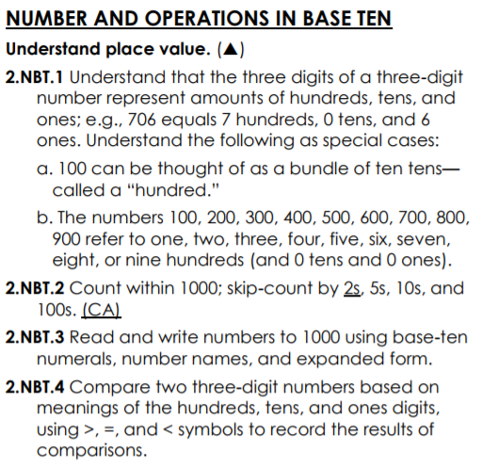
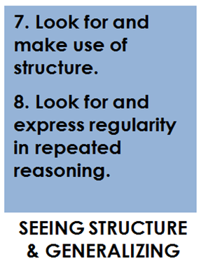
SET MATH PRACTICE FOCUS
MATH PRACTICE
Notes:
One way to plan for using Math practices is connecting it to the Content Standards we are teaching. Why might these MPs connect/align with what students are doing with this content?

Slide 9
SET MATH PRACTICE FOCUS
MATH PRACTICE
Notes:
One way to plan for using Math practices is connecting it to the Content Standards we are teaching. Why might these MPs connect/align with what students are doing with this content?

Slide 10
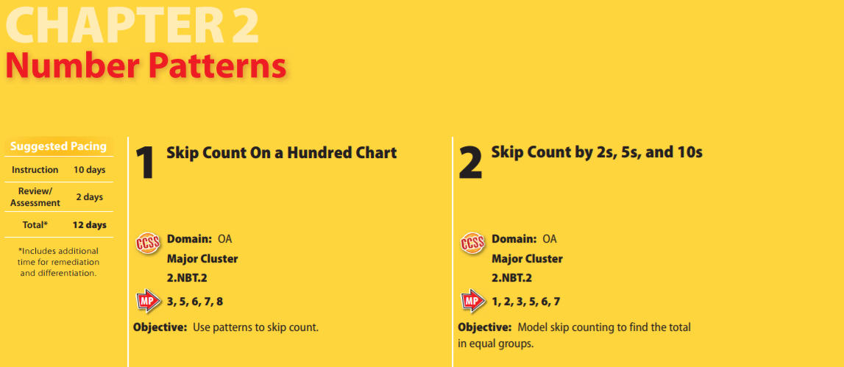
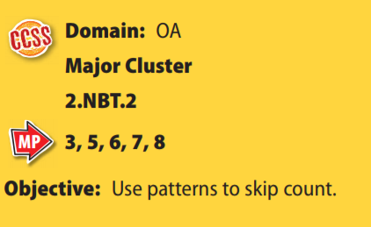
PLAN FOR IMPLEMENTING THE MATH PRACTICE STANDARDS
My Math shares which MPs are highlighted in the TE for each lesson in each chapter.
Notes:
Another way to plan around Math Practices is to use the supports in MY Math.

Slide 11
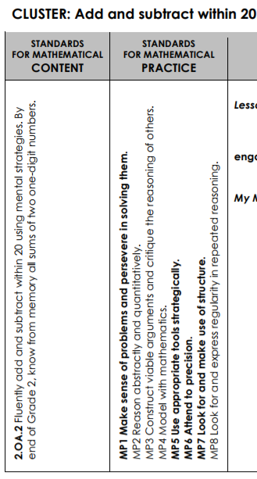
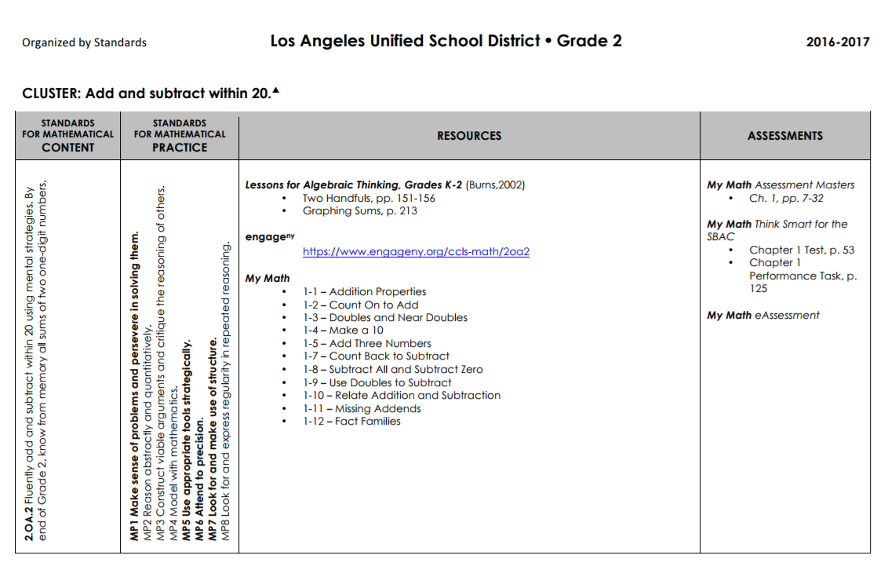
PLAN FOR IMPLEMENTING THE MATH PRACTICE STANDARDS
Notes:
Another way to plan around Math Practices is to use the supports in the Math Curriculum Maps. Content standards are paired with bolded practice standards in the maps, with suggested resources that support the instruction of both sets of standards. Rigorous tasks are a good place to start.

Slide 12
PLANNING FOR MATH PRACTICE STANDARDS
Notes:
In Elicit, we develop a plan and put it into action. How will the Math Practice be implemented? How will the students be introduced to the Math Practice? What materials are needed? What adjustments will be made for special populations? How might the Math Practice help meet student needs?
And what evidence to you want to see? How will you collect evidence of students’ proficiency in the focus Math Practice? Then the lesson is taught.

Slide 13
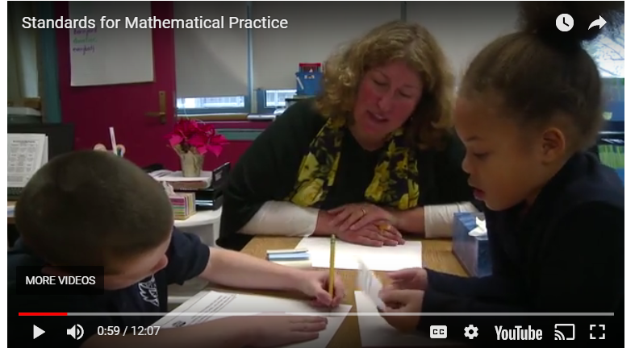
PLAN FOR IMPLEMENTING THE MATH PRACTICE STANDARDS
http://www.hunt-institute.org/resources/2015/04/nctm-mathematics-video-series-standards-for-mathematical-practice/
Notes:
Let’s observe a lesson so that we can see and hear the math practices in the classroom.
Task: View the video and record observations: What do you see and hear that shows the students’ use of the math practices in these areas.
Take notes in 4 categories:
Problem Solving and Precision
Reasoning and Explaining
Modeling and Using Tools
Seeing Structure and Generalizing
Turn and discuss with a partner. Add things to your list. Share out whole group.

Slide 14
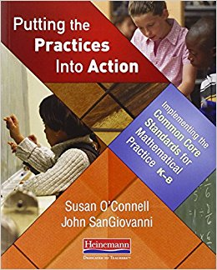
PLAN FOR IMPLEMENTING THE MATH PRACTICE STANDARDS
Notes:
This book is also a great resource to support planning to implement the Math Practices. There is a chapter on each MP Standard. (Local districts will receive a limited number copies of this book, funded through the Special Education Office, for professional development.)

Slide 15
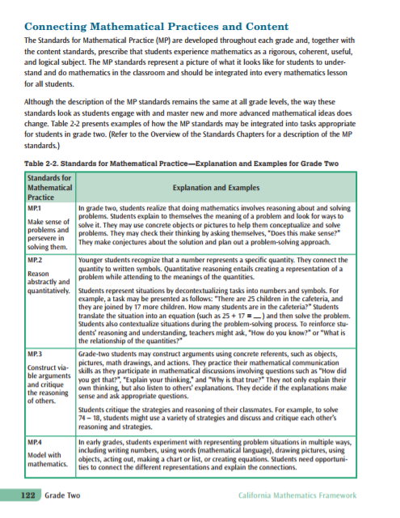
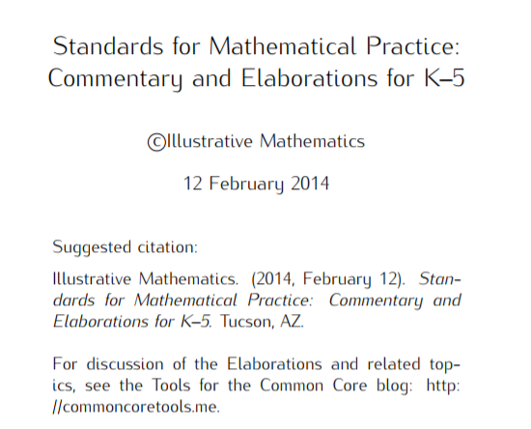
PLAN FOR IMPLEMENTING THE MATH PRACTICE STANDARDS
CA MATH FRAMEWORK
MATH PRACTICE
ELABORATIONS
Notes:
Reading about our Math Practices is also helpful for planning.
Read about MP3 at your grade level in the CA MATH FRAMEWORK (HO 3) and read about MP3 in the ELABORATIONS (HO 4) document.

Slide 16
PLAN FOR IMPLEMENTING THE MATH PRACTICE STANDARDS
MATH PRACTICE 3
CA MATH
FRAMEWORK
MATH PRACTICE
ELABORATIONS
Notes:
Take notes on what students need to Know, Understand, and Do as you read. Be ready to share out.

Slide 17
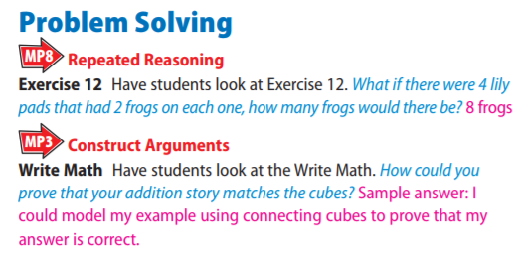
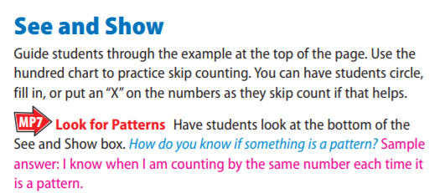
PLAN FOR IMPLEMENTING THE MATH PRACTICE STANDARDS
Notes:
My Math can support planning because there are various sections in the TE that gives you ideas on how you can support that Math Practice.

Slide 18
PLANNING FOR MATH PRACTICE STANDARDS
Notes:
Now that we’ve taught the lesson, we move to the next step. In Interpret, we think about next steps and reflect on the implementation of the focus math practice. Next steps may include such questions as: How will the math practice evidence be analyzed? How will the math practice inform instructional next steps? Reflection includes: How did the math practice benefit teaching and learning in your classroom?

Slide 19
IMPLEMENTATION OF THE FOCUS MATH PRACTICES
Collaboration
Grade Level
Reflection
Examining Student Work
Taking Anecdotal Notes/Pictures
Listening to Student Thinking
Asking Students Questions
Notes:
Collaboration is key. The more discussions we can have among each other and in our grade level about what the Math Practice should look and sound like in our classrooms, the stronger our planning and our understanding will become.

Slide 20
IMPLEMENTATION OF THE FOCUS MATH PRACTICES
Notes:
Teacher moves, such as asking purposeful questions, also supports development of the Math Practices in our classrooms. (HO 5-8)

Slide 21
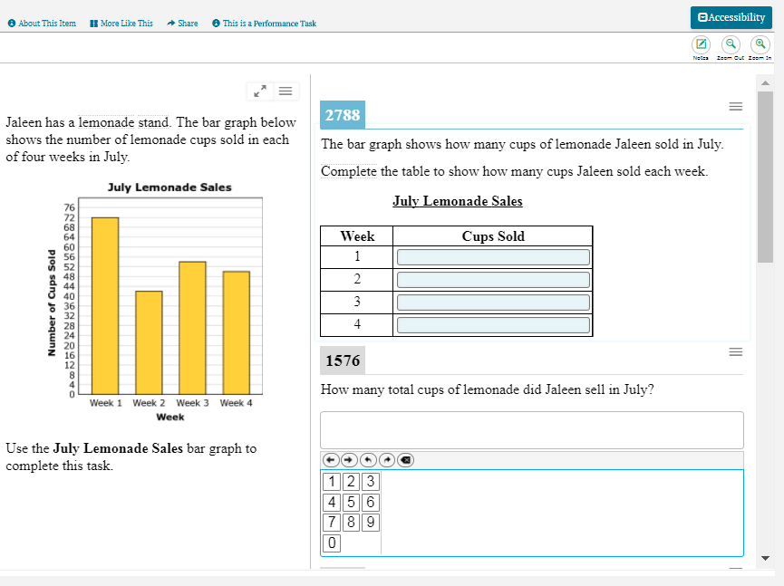
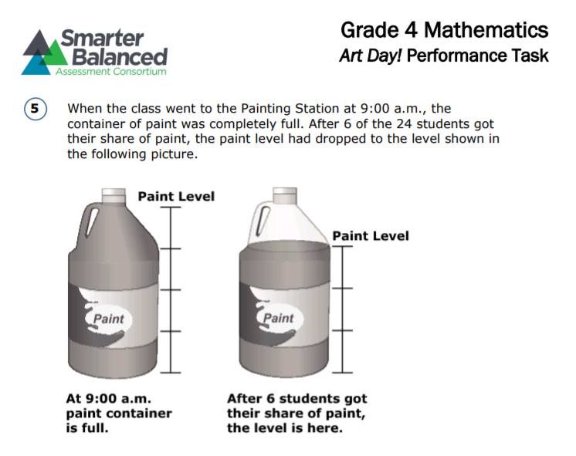
IMPLEMENTATION OF THE FOCUS MATH PRACTICES
Notes:
SBAC also assesses Math Practices. Questions in Claim 2,3,4 focus on the integration between content and practice standards.
Questions in Claim 1 also integrate some math practices. The performance task is the primary way that SBAC assesses the math practices.

Slide 22
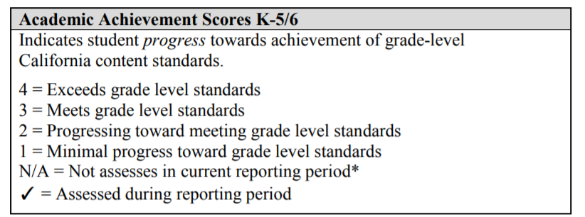
IMPLEMENTATION OF THE FOCUS MATH PRACTICES
The MyPLN module shows Math Practices as a check off for each reporting period. This has been changed. Teachers will enter a score of 1-4 instead.
Notes:
On our new report card we will be scoring MPs with a 1-4 score. You can write N/A for any MPs you have not been focusing on during that reporting period.

Slide 23
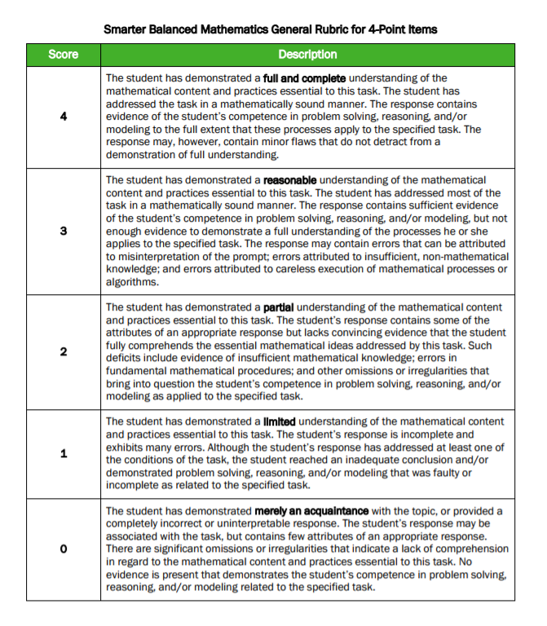
IMPLEMENTATION OF THE FOCUS MATH PRACTICES
FULL AND COMPLETE understanding of the mathematical content and practices essential to the task.
REASONABLE understanding of the mathematical content and practices essential to the task.
PARTIAL understanding of the mathematical content and practices essential to the task.
LIMITED understanding of the mathematical content and practices essential to the task.
Notes:
Here is another resource from SBAC that can support scoring around the Math Practice Standards. (HO 9)

Slide 24
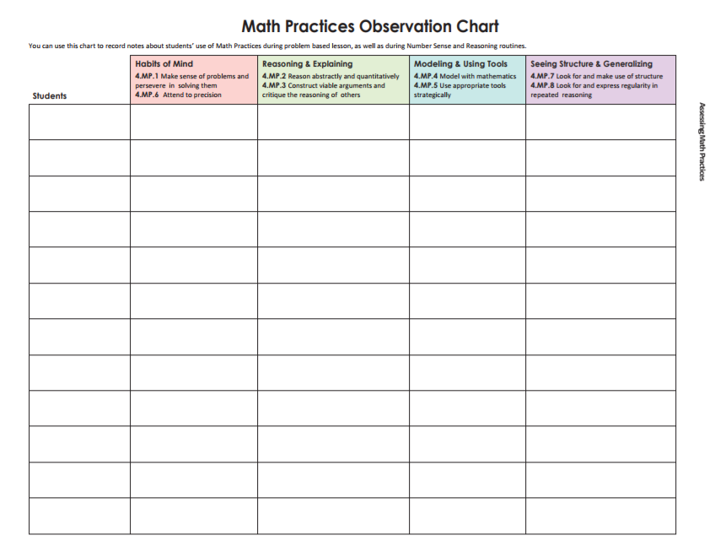
IMPLEMENTATION OF THE FOCUS MATH PRACTICES
Notes:
Here is an observation chart that can support scoring around the Math Practice Standards. (HO 10)

Slide 25
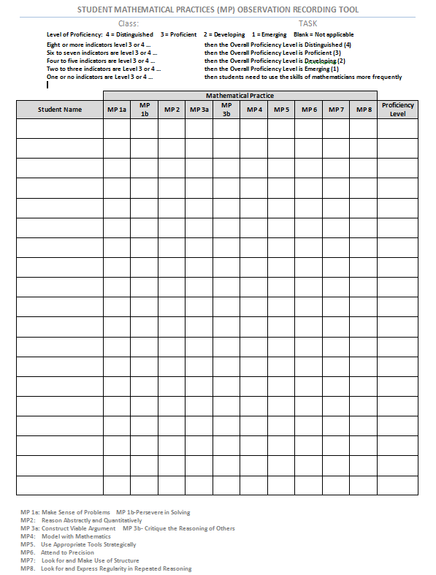
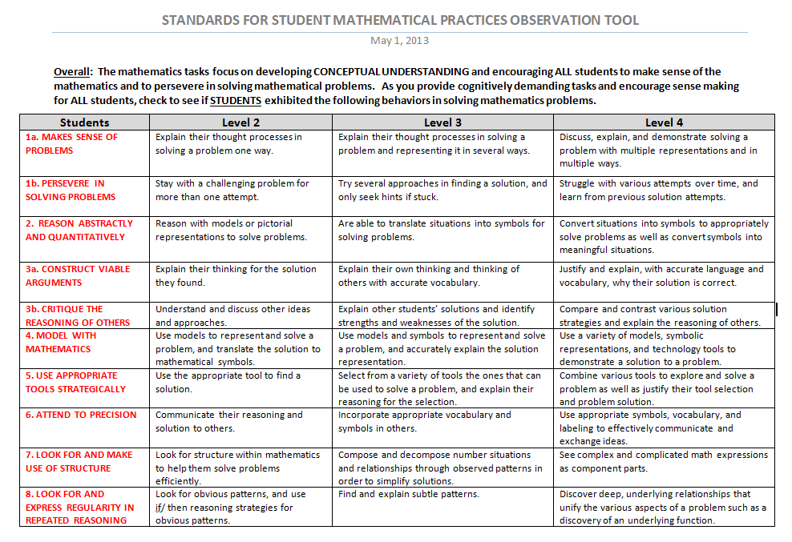
IMPLEMENTATION OF THE FOCUS MATH PRACTICES
Notes:
Here is another Observation tool that provides leveled indicators. While the numbered score language is not a direct match to the progress report, it does provide for a similar numbered score, for example, a 4, “Distinguished” could be interpreted as “Exceeds”. It can be used as a tool to to show developing proficiency across the math practices. There is a descriptor page (HO 11) and an observation page (HO 12).

Slide 26
SHARE PROFESSIONAL LEARNING
Notes:
In the Act stage, we share our professional learning. (next slide provides full frame for discussion)

Slide 27
SHARE PROFESSIONAL LEARNING
After teaching a lesson or a unit we can share/reflect together.
Summarize the Math Practice you implemented and share the benefit to teaching and learning.
How do you plan to use that Math Practice in the future? What adjustments would you make? Why?
Notes:
Finally, we reflect together. Here are the prompts: Summarize the math practice you implemented and share the benefit to teaching and learning. And think ahead, how do you plan to use that math practice in the future? What revisions or adjustments might you make, and why would you make them?
In summary, planning for the instruction of the Standards of Mathematical Practice is the first step in developing student grades in these areas for the new elementary progress report.

Slide 28
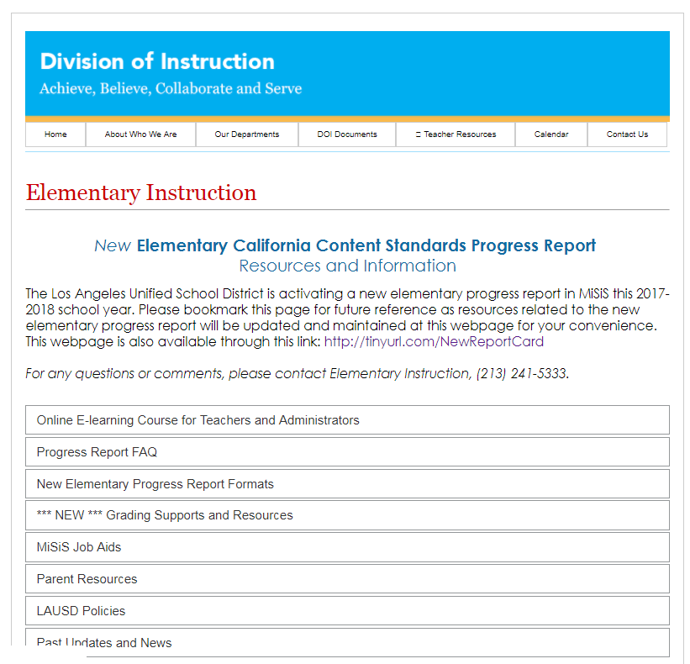
SHARE PROFESSIONAL LEARNING
www.tinyurl.com/NewReportCard
Notes:
Please share this with your teachers.

